Slide 1
Employee Data Analysis using Excel
STUDENT NAME: MANASA RAMAN
REGISTER NO: 5F207B038417448B27F4220A72B0B62E
DEPARTMENT: B.COM(GENERAL)
COLLEGE:MEENAKSHI COLLEGE FOR WOMEN

Slide 2
PROJECT TITLE
Employee Classification status and performance Analysis using Excel

Slide 3


AGENDA
Problem Statement
Project Overview
End Users
Our Solution and Proposition
Dataset Description
Modelling Approach
Results and Discussion
Conclusion
3/21/2024 Annual Review

Slide 4

PROBLEM STATEMENT
In a company, the employees are of three types- full time, part time and temporary. There are many questions arising in the company as to whether the employee classification status given above has anything to do with their performance analysis and not just their capabilities.

Slide 5

PROJECT OVERVIEW
.
This project aims to analyse the performance levels of all the employees of the company according to their employee classification status whether they are working full time, part or temporary affects their performance in the company. This project will represent how employee classification type affects their job performance.

Slide 6

WHO ARE THE END USERS?
The end users of this project are all the employees of the company at various levels within the company, ranging from entry level to senior management. These employees, no matter whether they are part time, full time or temporary, will benefit from this analysis because it shows their performance score. It will help them to analyse whether they should change their employee status, or work harder for giving a better performance. The ultimate goal is to improve their performance capabilities.

Slide 7

OUR SOLUTION AND ITS VALUE PROPOSITION
Our solution involves implementing various analysis and computation techniques designed to ascertain whether the employee classification type actually affects the performance of the employee. By doing this, we can find out how many employees who work full time do not meet job expectations, and need to improve, and if employee classification status really affects their performance status.

Slide 8
Dataset Description
The dataset provides a detailed overview of employees within the organisation, encompassing key variables like job classification type and performance score. It catagorises various employees across various departments, whether they work part time, full time or temporary and also their job performance- whether they meet expectations, or need improvement. By analysing this dataset, we can assess if employee classification status affects the performance score, and we can make strategies to improve them.

Slide 9

THE "WOW" IN OUR SOLUTION
Our excellent solution provides a clear cut analysis on whether employee classification status affects job performance or not. Where employees work full time and do not meet expectations, we will make an improvement plan for them, and help them on improving. This goes for all the other employees as well.
3/21/2024 Annual Review
9

Slide 10
MODELLING
Our model for analysing employee performance analysis with regard to their classification status, provides a comprehensive framework for understanding and addressing the same. It incorporates variables like departments, performance, job role, employee status and other things. Through this organisations can ensure that rather than the employee status, it is the capability of the employee himself that impacts his performance, since many part time employees meet the expectations.
10

Slide 11
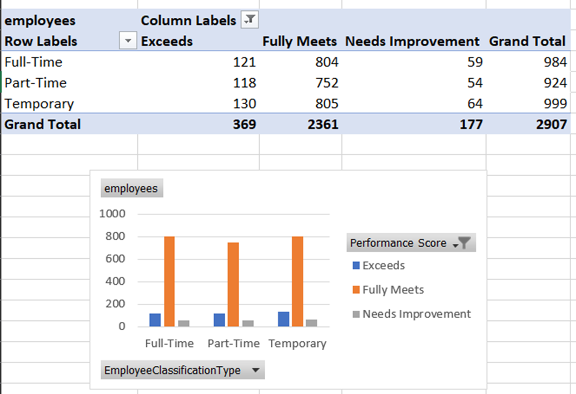
RESULTS
11

Slide 12
conclusion
In conclusion, we can see that most of the employees whether they work part time, full time or temporarily meet the employee expectations of the company. Hence the employee classification status has nothing to do with the performance, it lies within the capability and hardwork of the employee only. So by doing this analysis, we can understand the same and help those employees who need to improve and address the complaints.

